Slide 1
Theory of Change Revision Guide: Adapting to Achieve Development Results

Slide 2
INTRODUCTION TO THIS GUIDE
TIP: Click the house to go to the start of the revision process!
About this resource:
The Theory of Change (TOC) Revision Guide was originally created for USAID/Vietnam and its implementing partners to use as part of TOC reviews. It can be used internally or with external stakeholders, either in-person or online. The Activity’s Agreement/Contracting Officer Representative (A/COR) should also be engaged.
Note that this slide deck is not intended to be used as a standard presentation deck. Your team should use the many links and buttons to navigate through the file based on your responses to the prompts.
The tool was designed with close reference to the Theory of Change Workbook and should be used as a companion to that resource.
Links to theory of change resources:
Theory of Change Workbook: A Step-by-Step Process for Developing or Strengthening Theories of Change
Theory of Change samples
TIP: Click the red arrows to go back!
TIP: Click the blue arrows to go forward!

Slide 3
First things first: does your activity have a TOC?
Of course!
(click here)
A what…?
(click here)

Slide 4
Does your TOC…
…respond to a clear development problem?
…have clear outcomes?
…follow pathways to achieve those outcomes?
…use an accompanying visual?
Note: an if-then statement is not enough!
Yes!
(click here)
No…
(click here)

Slide 5
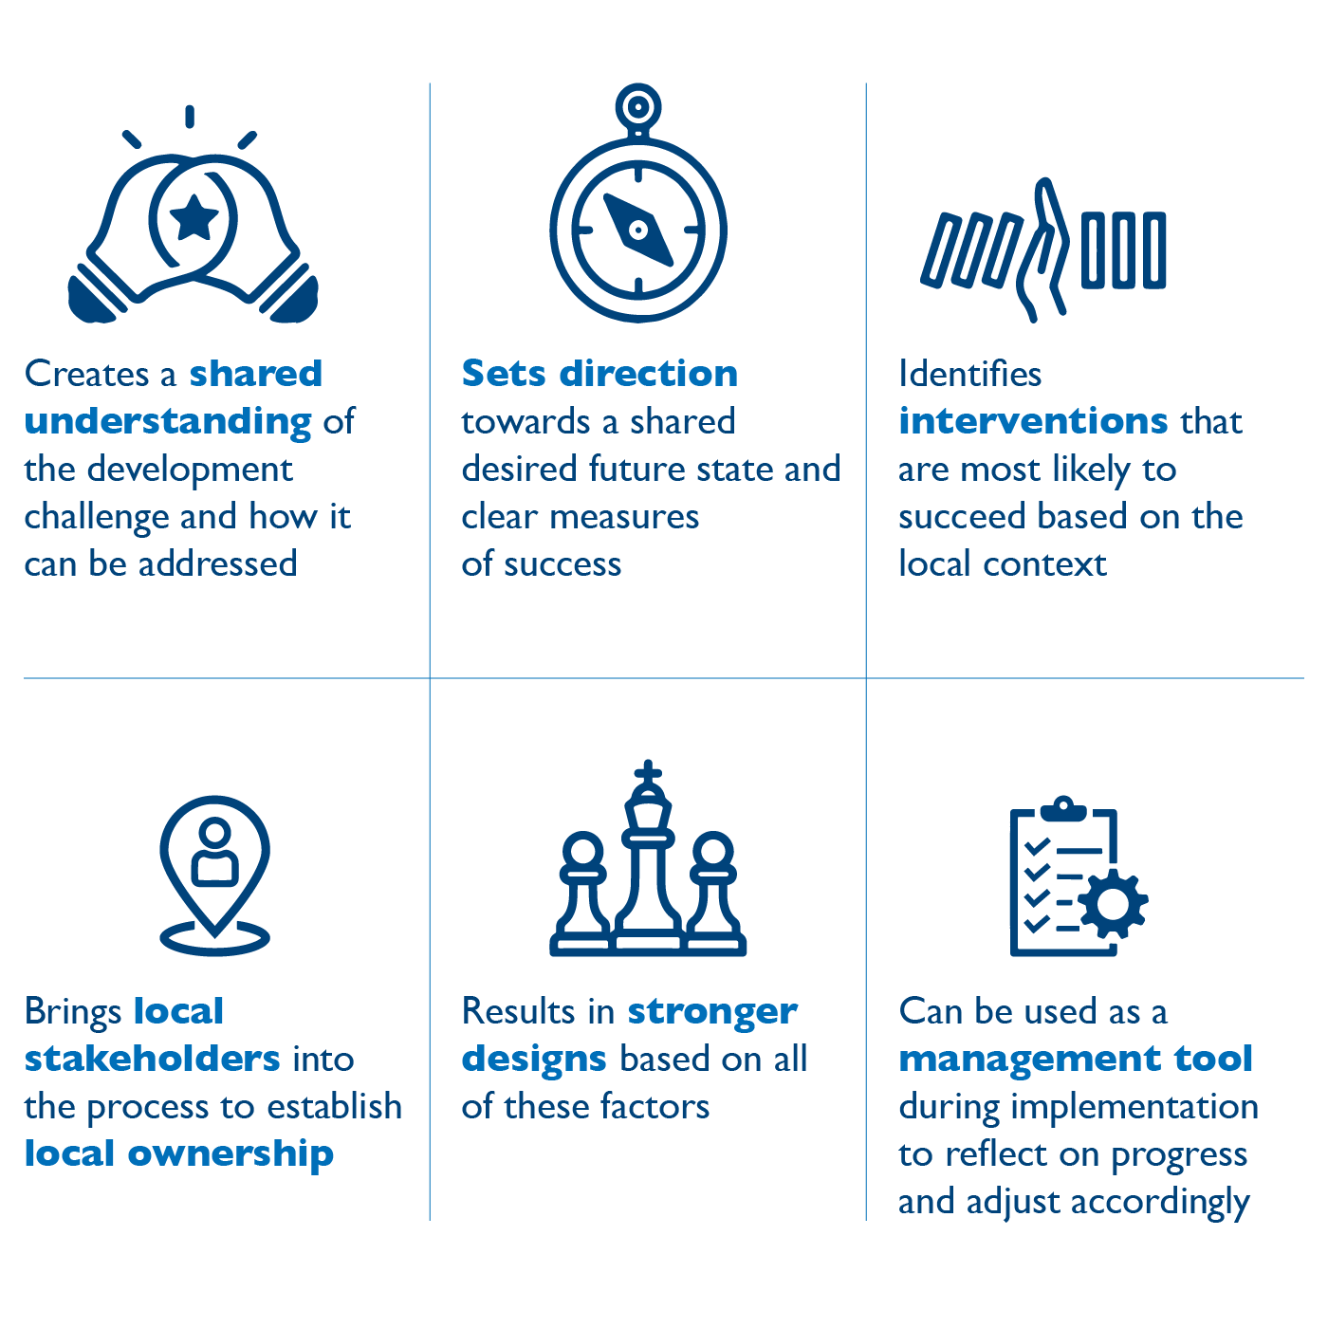
You need a strong TOC!
A robust theory of change is essential for your activity because it…

Slide 6
Great! You already know why a TOC is important.
To recap, a TOC…

Slide 7
What makes a strong TOC?

Slide 8
Both Process and Product

Slide 9
Example: Reducing Youth Recidivism
Outcomes
Fiscal incentives
Legislators adopt changes to fiscal incentives
Resources re-allocated from national jails to local ARCs
TA for policy support with champions in leg
Increased # and quality of ARCs nationwide
ARCs
Twelve model districts selected
ARCs in 12 model districts strengthened
Increased % of convicted youth who are sentenced to ARCs by judges nationwide
Reduced recidivism rate of youth
Entry Points
Improved standards/oversight implemented by judges in model districts
Capacity building of ARCs in 12 model districts
TA for local govts on standards & regulations
Increased % of convicted youth who are sentenced to ARCs by judges in 12 districts
Seed funding for 12 model ARCs
Judicial behavior
Local judges aware of
value ARC model
Critical Assumptions
Political will remains at national and local levels to sustain reform process
Judicial tours of San Lola ARCs
ARCs provide transformative service that enables youth to break out of criminal cycle
Capacity building of judges
Demonstration effect of successful ARCs sufficient to spread the model nationwide
Interventions
Assumptions

Slide 10
Ready to get started?
Choose the blue door to make a new TOC!
Choose the red door to revise your current TOC!

Slide 11
Before we start revisions…
Ask yourself: why do you want to revise the TOC?
Remember: revising a TOC is important to keep your activity on track, but it can be a significant undertaking needing a lot of stakeholder input.
Good reasons to consider reviewing your TOC include:
Change in leadership, new team members or new stakeholders involved with the project
Preparing for annual work planning
Failing to achieve expected results
Significant change in the context
New evidence suggesting a change in approach is needed

Slide 12
Before we start revisions…
When does it make sense to revise a TOC?
Ideal times to revise a TOC include:
Following an evaluation
During a Pause and Reflect session
After a key project milestone (e.g. annually or at the midpoint)
Who should we include in our TOC revision process?
Stakeholders to consider consulting during this process include:
Team members
Your A/COR & other USAID colleagues
Local partners & government counterparts
Sector experts
Ready to continue?
Click here!

Slide 13
THE PROBLEM AND ITS CAUSES
What have you learned so far?
Before reviewing the components of the TOC, it’s worth taking a moment to review what we know about our development problem and the dynamics around it.
Discuss the following questions with your team:
What have we learned about the problem since we created or last reviewed the TOC?
What have we learned about the context of the problem? What has changed?
What do these insights mean for our TOC review?

Slide 14
What should we review?
Note: the four elements are interconnected, and working on one may encourage you to shift to another.
Click on the red text of the element you would like to review.
ENTRY POINTS
INTERVENTIONS
Click here if your project is having trouble getting started and/or finding momentum and champions to create change.
Click here if you're not sure if your project is moving in the right direction, or if you feel your interventions aren't adding up to positive outcomes.
OUTCOMES
ASSUMPTIONS
Click here if you’re not sure what your project is trying to achieve or you are not able to address your main issue.
Click here if the context has significantly shifted or if causal linkages in your TOC are not holding.
We recommend starting here!
Finished updating your TOC? Click here:

Slide 15
OUTCOMES
Are you on track to achieve your outcomes?
Many activities feel they need to revise their theory of change because they are not achieving their intended outcomes. Click one of the prompts below that aligns with your situation to explore possible next steps.
It is too early to tell whether we have achieved anything, and we aren’t sure how to measure it.
We think we are on track based on what our data is telling us.
We are off track! (or, we are delivering our outputs, but not achieving our intended outcomes)
Our outcomes don’t make sense anymore, and we need to develop new ones.
Finished updating your TOC? Click here:

Slide 16
OUTCOMES
It’s too early to tell if we are achieving our outcomes.
Maybe you’re just getting started – or maybe you’re having trouble with measuring your results.
Discuss the following questions with your team:
What are we trying to achieve? Why does it matter, and to whom?
Do we have specific and measurable outcomes? How are they being tracked?
Have we established baselines and targets?
How confident are we in our measurement approach? Is anything missing?
Could we triangulate that information through some additional approaches?

Slide 17
OUTCOMES
It’s too early to tell if we are achieving our outcomes.
How will you know that you are making progress? What could show you that you are on the right track?
Approach | Details
Proxy Indicators | Used to measure change where an outcome cannot be directly measures.
Outcome Mapping | Tracks changes in partner behaviors to understand whether outcomes are being achieved.
Outcome Harvesting | Retrospectively identifies outcomes and the processes that contributed to them.
Most Significant Change | Reviews a range of stories of change and determines which was the most significant.
Contribution Analysis | Gathers evidence on whether a program contributed to a change using a TOC approach.
TIP: Click here to visit the USAID Learning Lab, which has many more resources on a wide variety of topics.

Slide 18
OUTCOMES
We’re on track!
So, the data is telling you what you’re doing is working – that’s great! Here are some thoughts to help you stay on track.
Discuss the following questions with your team:
Are we monitoring the right things? What might we be missing and why?
Are we unintentionally causing anything else to happen through our work? What are the implications of this?
Could we be keeping better watch of the context to ensure things stay on track?
What do local stakeholders think of our work? Have we adequately made sense of and responded to beneficiary feedback?

Slide 19
OUTCOMES
Uh oh – seems we’re off track.
OK – let’s get you headed in the right direction.
It might also be helpful to look at the other parts of your TOC to help you get on track. Click one of the buttons below to head there.
Discuss with your team members:
What did we expect to happen?
What is happening instead?
What explains the difference?
Entry Points
Interventions
Assumptions

Slide 20
OUTCOMES
We need new outcomes!
Detailing clear outcomes is critical to knowing whether your activity is bringing about change.
Discuss the following questions with your team:
Given the context and entry points, what kind of development result is possible and why?
What in the system needs to change in order to bring this about?
Who needs to think or act differently in order to bring about your development result? In what ways?
Are these changes specific and measurable?
TIP: Click here to review the TOC Workbook, which has many more guiding questions on developing outcomes.

Slide 21
ENTRY POINTS
Where is there momentum for your work?
An entry point is an opening for your activity to build momentum in the local context. Without an entry point, your interventions likely will not gain sufficient traction to succeed. Entry points come in a few different forms:
Type | Definition
Open doors | Opportunities for change or reform in which a broad constituency already exists that requires only a catalyst to achieve progress. If you have an open door, go for it!
Locked doors | Opportunities for which change is possible, but will require concerted effort to open them. To unlock the door, you need the right key.
Brick walls | Certain reforms or changes are likely to face such entrenched resistance that it may be a misallocation of resources, political capital and time to attempt to shift them. Avoid, stop, turn around.

Slide 22
ENTRY POINTS
Where is there momentum for your work?
Your activity might be well staffed, well designed, and doing the right things. But without local interest and momentum, your ideas may not be taken up, and change might not be sustainable. Let’s make sure you’re working with the right entry points. Click below!
We feel confident we still have the right entry points and momentum for our work.
A new entry point appears to be emerging (and we could make some progress through it).
We thought we had an open door, but now it’s a brick wall (no longer able to make progress).
We never identified any entry points (or they don’t make sense any longer and we need to find new ones).
Finished updating your TOC? Click here:

Slide 23
ENTRY POINTS
Our entry points are still the right ones.
Great! Keep making use of those open doors to make change happen.
Discuss the following questions with your team:
What makes us believe these are still the right entry points?
Are we making the best use of them?
Could our approach be reframed to interest a wider group of local stakeholders?
It might be worth checking in on the other parts of your TOC. Use the links below to move to that section.
Outcomes
Interventions
Assumptions

Slide 24
ENTRY POINTS
A new entry point might be emerging.
It seems momentum might be opening in a new area, giving your activity space to work. How can you be sure this is an entry point? How can you build on this momentum?
Discuss the following questions with your team:
To confirm an entry point:
Who is interested in this issue? What level of influence or authority do they have over it?
Is there agreement over the nature of the issue?
Do you or your partners have the skills, relationships and resources needed to tackle the issue?
To build on an entry point:
What do you propose to do?
How does this leverage the existing momentum? Is there demand for our solution?
What is a feasible outcome from this effort?

Slide 25
ENTRY POINTS
A door is closing and might now be a brick wall.
Momentum for your work is slowing, and there may be opposition to it. Where to go from here?
Discuss the following questions with your team:
What is constraining momentum for your work? Who or what is driving this?
What does this mean for your current interventions?
Could the issue be reframed to attract new or different local stakeholders and create a new entry point?
Are there alternative activities that could help prepare for a new opening, such as technical research or networking with similar organizations?

Slide 26
ENTRY POINTS
We never identified any entry points.
Identifying an entry point can help target your work and ensure you are aligned with local priorities.
Discuss with your team members:
Where is there momentum for change? To identify where there is genuine interest in change, review recent policy documents, new local initiatives, statements from influential individuals, or similar.
Where is there potential for ripple effects (when change in one area can spark change in other areas)?
Where are there bright spots (small changes, new innovations) that can be built upon?
Where are things stuck?
Use this discussion to identify your entry points, and then move to the next section of your TOC.

Slide 27
INTERVENTIONS
How are you working together? What are you delivering?
Interventions are all about the work you are doing to achieve your outcomes, and how your team and stakeholders work together. Check in on your interventions through the statements below.
We are on track to deliver our interventions and achieve our outcomes.
Our interventions are not leading to our intended outcomes or unintended negative outcomes.
It’s too early to tell if we are making progress, or it is not yet clear.
Local stakeholders are not supportive of our interventions.
Finished updating your TOC? Click here:

Slide 28
INTERVENTIONS
Our interventions are on track.
Keep up the good work.
Discuss the following questions with your team:
Are we monitoring the right things? What might we be missing and why?
Are we unintentionally causing anything else to happen through our work? What are the implications of this?
Could we be keeping better watch of the context to ensure things stay on track?
Are there alternative or new approaches we could add to our activity?

Slide 29
INTERVENTIONS
Our interventions are on track.
Here are a few questions for further reflection.
Discuss with your team members:
What is helping us stay on track? How do we build on this progress?
Is there anything we could start doing to go further with our project?
Could we share our insights from implementation with others?
Consider other aspects of your TOC:
Outcomes
Entry Points
Assumptions

Slide 30
INTERVENTIONS
Our interventions are not leading to expected outcomes.
Oh no! Let’s think about why this might be.
Discuss with your team members:
What in our approach to implementation should we continue doing (even if it feels like things are off track)?
What should we consider stopping doing to help us get on track?
Is there anything we could start doing?
How could we better monitor our outcomes?
For all these questions, consider your team dynamics, your relationships with local stakeholders and with USAID, and the resources available to you.
TIP: it may also make sense to review your outcomes. Click the button below to do so if you have not already.
Outcomes

Slide 31
INTERVENTIONS
It’s too early to tell if our interventions are on track.
OK – maybe you’re just getting underway. Let’s think about how to identify initial signals of progress.
Discuss with your team members:
Are there any initial signals of progress in your intervention (e.g., changes in knowledge or motivation)? Consider for example your core project deliverables – could they be broken down into clearer steps?
Are there any key drivers of change in your context that should be tracked or harnessed?
Are there local stakeholders that could advise you on next steps?

Slide 32
INTERVENTIONS
Local stakeholders are not engaged with our interventions.
You have a strong technical design, but local stakeholders are not bought in.
A lack of stakeholder buy-in often stems from a mismatch between intervention design and the local context.
Look for a new entry point and redevelop your interventions to work through the open doors you find.
Click the button to the right to reconfirm your entry points!
Entry Points

Slide 33
ASSUMPTIONS
Why do you think your approach will work?
Assumptions are the connective tissue of the theory of change, holding it all together, but are often left unstated. Why do we think that “if” will lead to “then”? If you are struggling with assumptions, consult the statements below.
The context for our program is changing significantly.
Our theory of change logic is not holding.
Finished updating your TOC? Click here:

Slide 34
ASSUMPTIONS
The context for our work is shifting and threatens our TOC.
The local context can shift rapidly and can undermine your TOC’s feasibility. Perhaps what was assumed to happen now seems unlikely.
A new entry point might help. Discuss with your team members:
Is there momentum for change in any form? Consider recent policy documents, new local initiatives, statements from influential individuals, or similar, to identify where there is genuine interest in reform.
Is there anything that could be done to attract greater interest in your current approach?
Are there alternative interventions that better align with the local context?
Click the button to the right for more on entry points!
Entry Points

Slide 35
ASSUMPTIONS
The logic of our TOC no longer holds.
Your TOC assumptions may no longer be relevant, or perhaps your interventions are producing different outcomes to those you expected.
Discuss with your team members:
Do all the elements of our TOC have clear assumptions? Do they suggest you have some level of control over the key mechanisms of change?
Are there additional necessary assumptions in our logic that we have not yet identified?
Should we review the evidence base for our interventions to confirm they align?
Should we re-examine the context to determine whether our TOC is the right fit?

Slide 36
WHAT NEXT?
REVISE YOUR THEORY OF CHANGE PRODUCTS NARRATIVE & VISUAL
WHY? Once you have reviewed your TOC, take the time to update your narrative and visual to reflect what you agreed to change. This helps keep the team and your key stakeholders on the same page.
PRO-TIPS:
Do this step as quickly as possible after any facilitated sessions or dialogues. You don’t want to forget all that great thinking!
All steps of this process are participatory, but this may be where participants break as a group and identify a skilled writer and/or visual thinker to assemble, with the wider group reviewing drafts. Consider who should do these initial drafts, who should review, and who ultimately approves your ToC narrative and visualization (known as the logic model).
Consult closely throughout the revision process with your key stakeholders, particularly your A/COR (who may liaise with OAA and others to modify your award), the Program Office (who may need to amend your activity approval memo), and key local counterparts, such as officials of the cooperating country. Consultation helps ensure a smoother process and longer term buy-in for your proposed changes.

Slide 37
ADDITIONAL RESOURCES
See the links below for further resources and reading on theories of change:
TOC WORKBOOK | The original resource on which this slide deck is based. Use it to develop your own theory of change using a set framework.
PROBLEM-DRIVEN ITERATIVE ADAPTATION | Resource on implementation developed by Harvard University. Useful for thinking through complex development problems and creating adaptive strategies for addressing them.
STRATEGY TESTING | An approach to theory of change development and revision developed by the Asia Foundation.
EVERYDAY POLITICAL ANALYSIS | Resource developed by the University of Birmingham with guiding questions on analyzing actors and exploring entry points.

Slide 38
ANNEX: DEFINITIONS
ASSUMPTIONS | The stated conditions and/or critical events outside the control of the activity that must be in place for outcomes to be achieved. Assumptions form part of the complete theory of change regarding the conditions under which change is envisioned to occur. They may be listed within the logic model itself, or to the side. (ADS201)
CONTEXT (OR SYSTEM) OR CURRENT STATE | In which the development challenge is situated. This includes root causes or drivers underlying the development challenge, as well as circumstances or conditions in the operating context that may affect intended Activity’s outcomes and are likely to change.
DESIRED FUTURE STATE | What stakeholders hope the situation will look like once the development challenge is addressed; described by SMART outcome statements.
ENTRY POINT | Momentum concerning the development challenge that could be leveraged to commence or expand an intervention.
INDICATORS | They are used to measure the most important expected Activity outcomes and assumptions. Indicators can be listed alongside the outcomes or assumptions that they represent within the logic model. At a minimum, they must be captured in the Activity Monitoring, Evaluation and Learning (MEL) Plan. (ADS201)

Slide 39
ANNEX: DEFINITIONS CONTINUED
INTERVENTIONS | What the Activity intends to implement to directly or indirectly influence a set of outcomes
LOGIC MODEL | A visual or graphic depiction that is a snapshot of a more complete (narrative) ToC. (ADS201)
OUTCOMES | The conditions of people, systems, or institutions that indicate progress or lack of progress toward achievement of program goals. They are any result higher than an output to which a given output contributes, but for which it might not be solely responsible. (ADS201)
OUTPUTS | The tangible, immediate, and intended products or consequences of an activity within USAID’s control or influence; the direct result of inputs. (ADS201)
RESULTS | They are significant and intended changes in a development condition that affect people, systems, or institutions. They are outputs and/or outcomes and are achieved as a result of the Activity’s interventions. (ADS201)
THEORY OF CHANGE | A narrative description, usually accompanied by a graphic or visual depiction (the logic model), that describes how and why a purpose or outcome is expected to be achieved in a particular context. It is focused in particular on mapping out or “filling in” what has been described as the “missing middle” between what a program or change initiative does (its activities or interventions) and how these lead to desired goals being achieved. (ADS201)

Slide 40
Disclaimer

